Slide 1
How do you carry out Big Data analytics campaigns for MediTech?
Applying CRISP-DM & ML Canvas

Slide 2
First Step: data context and problem

Slide 3
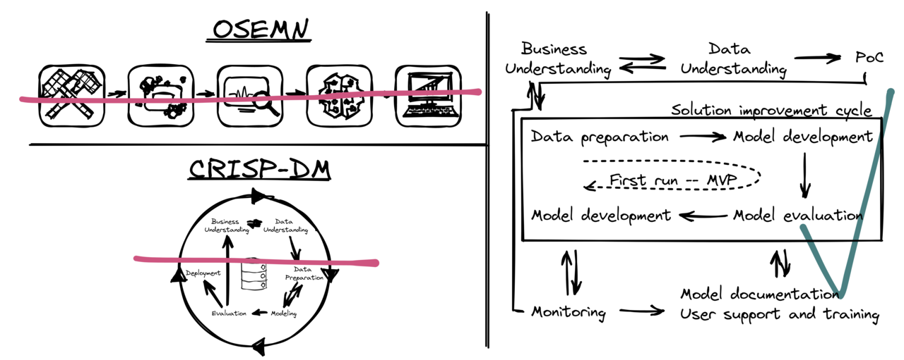
For example…

Slide 4
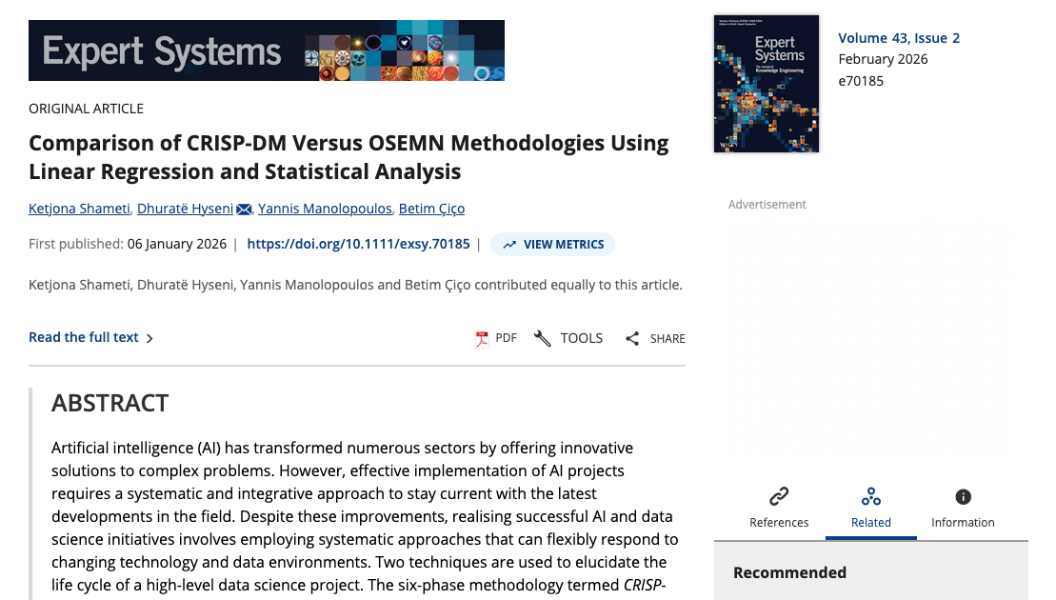

Slide 5
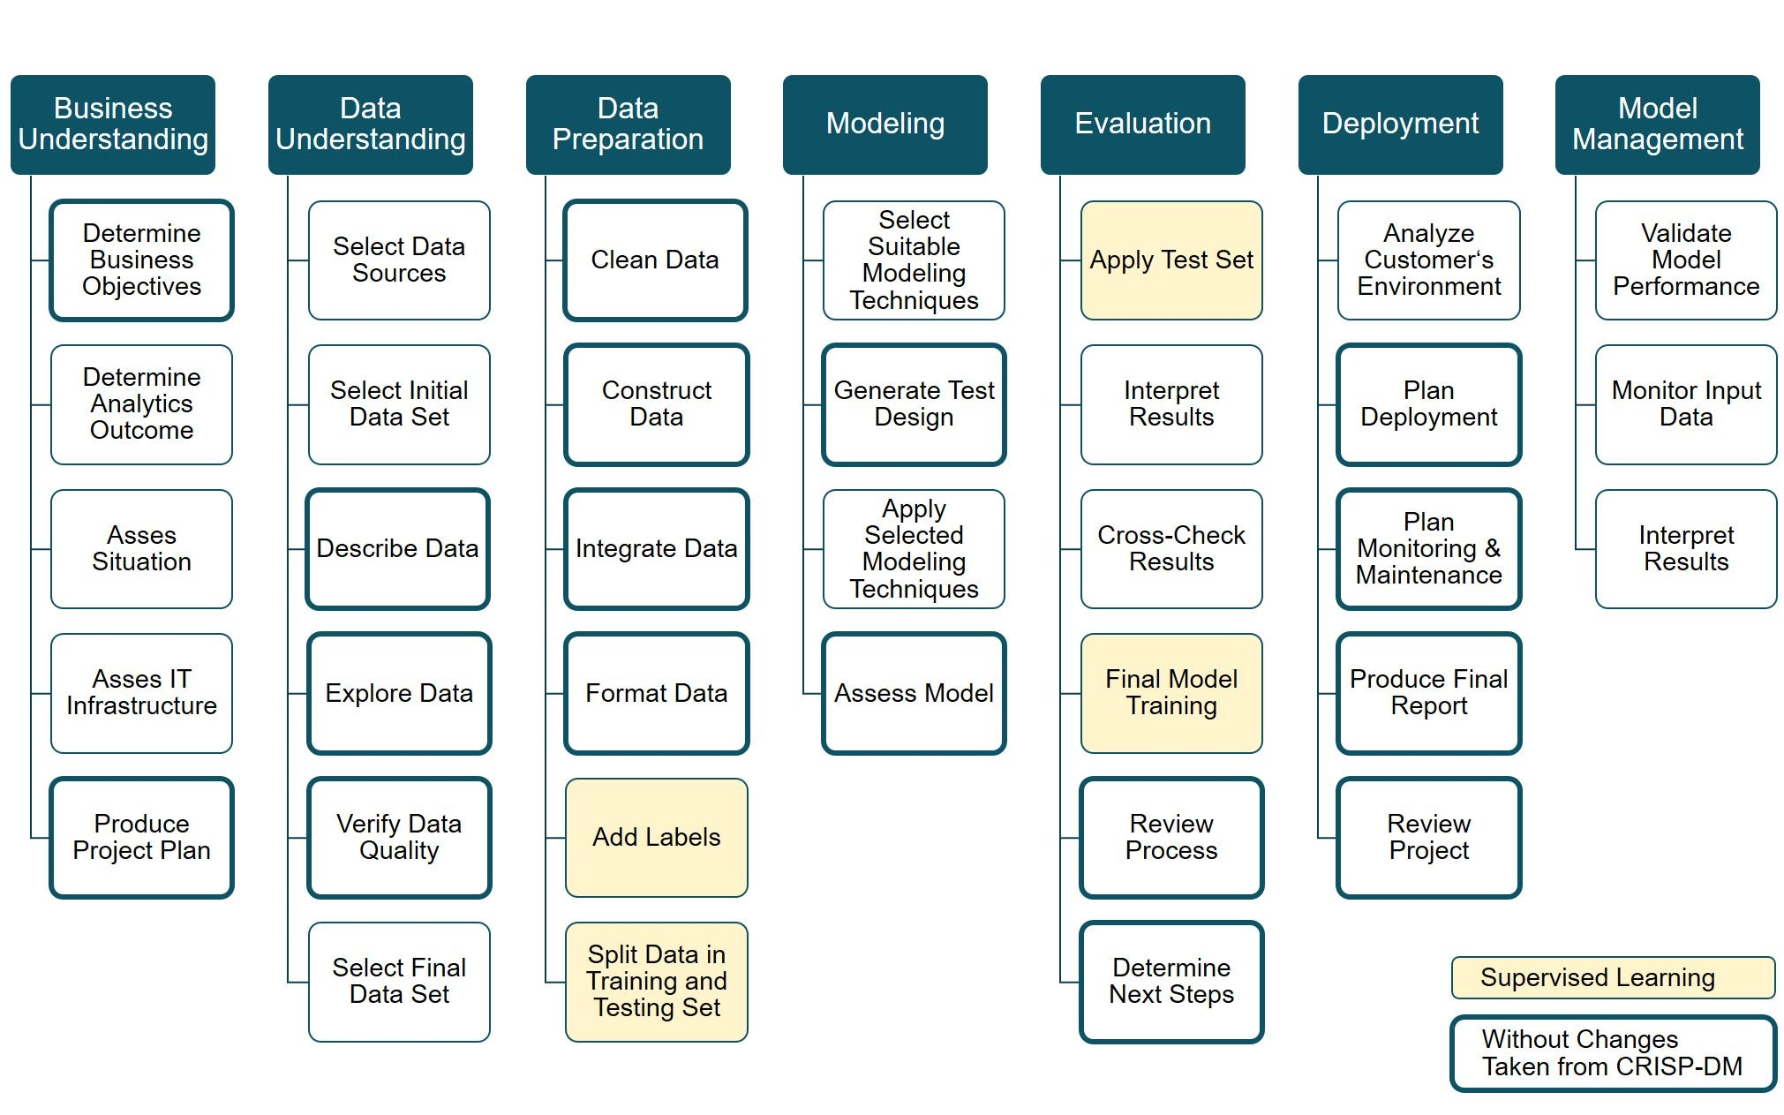

Slide 6
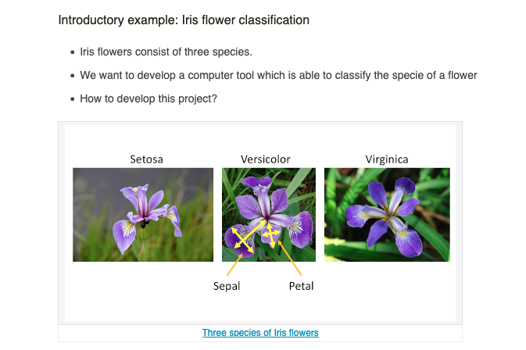

Slide 7
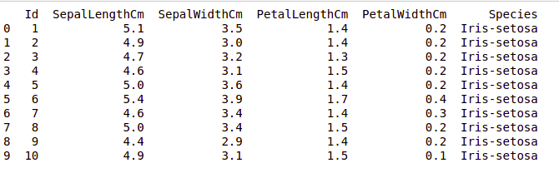
How does the dataset look like

Slide 8
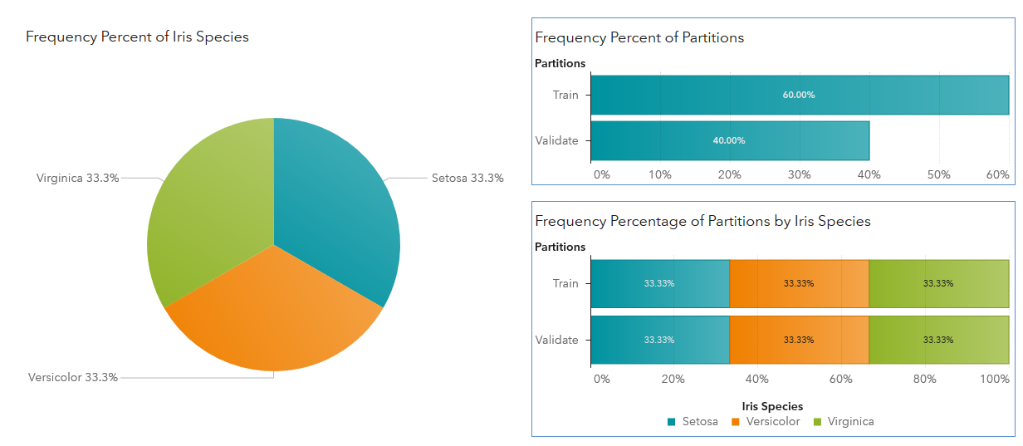
Describe it further?

Slide 10
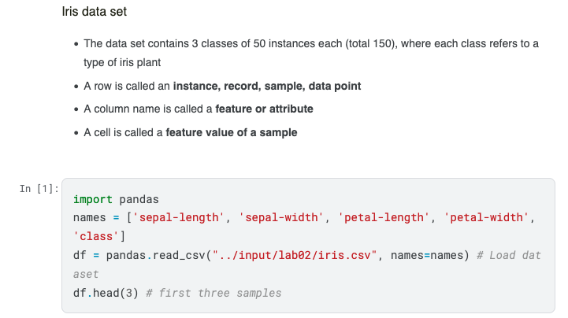

Slide 11
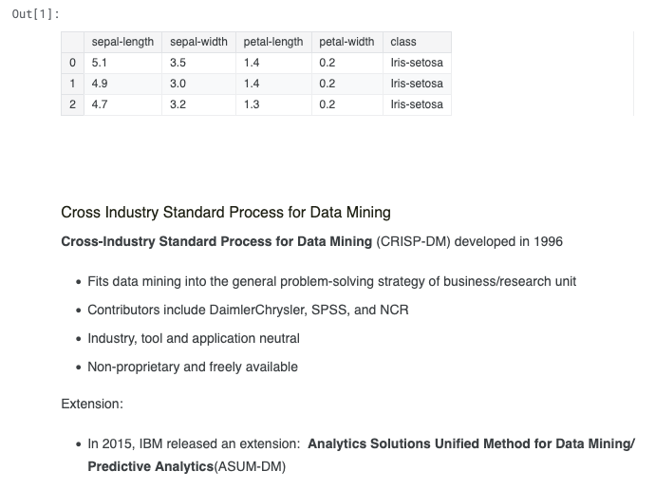

Slide 12
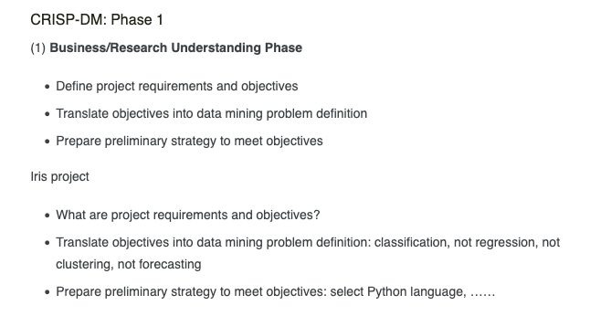

Slide 13
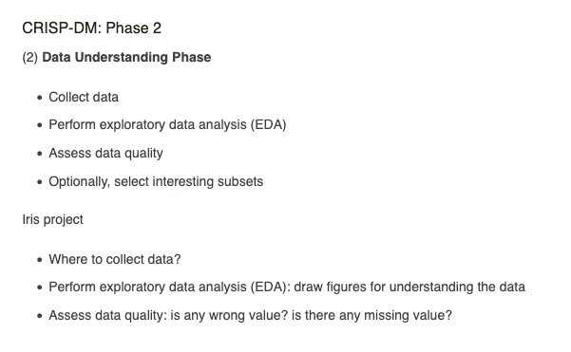

Slide 14
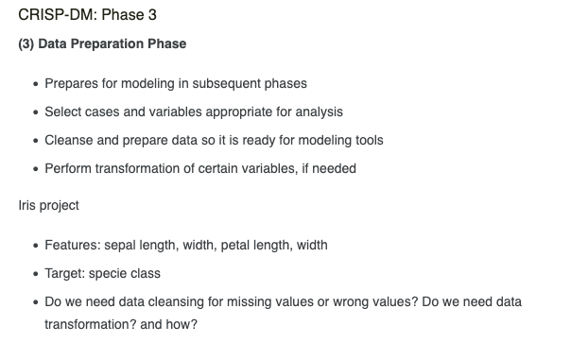

Slide 15
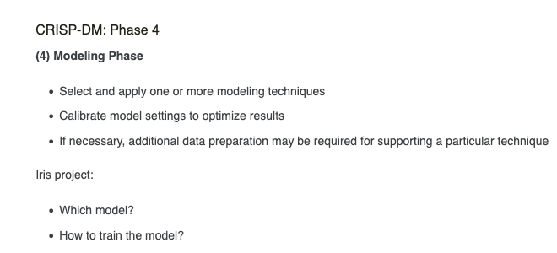

Slide 16
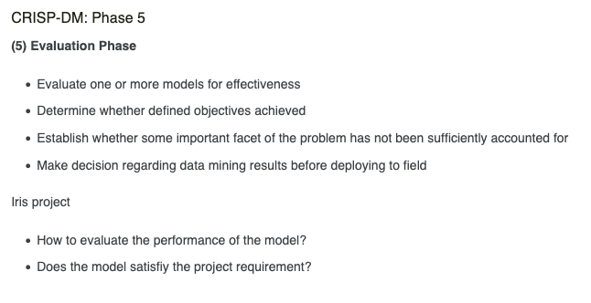

Slide 17
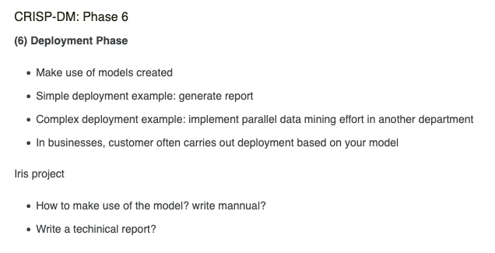

Slide 18
Second Step: The ML Canvas

Slide 19
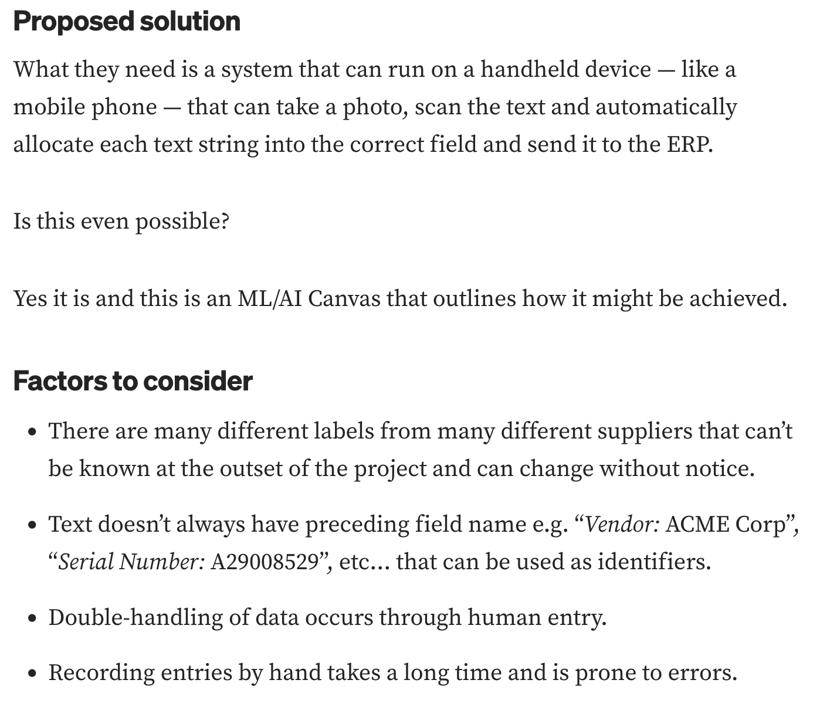
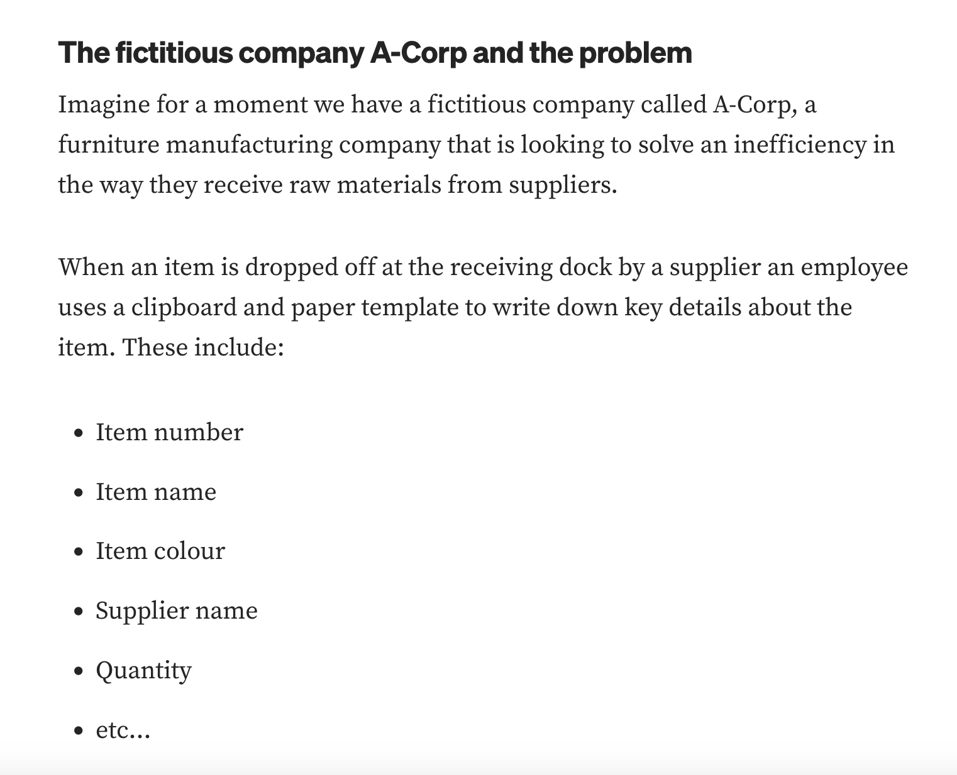
For Example…

Slide 20
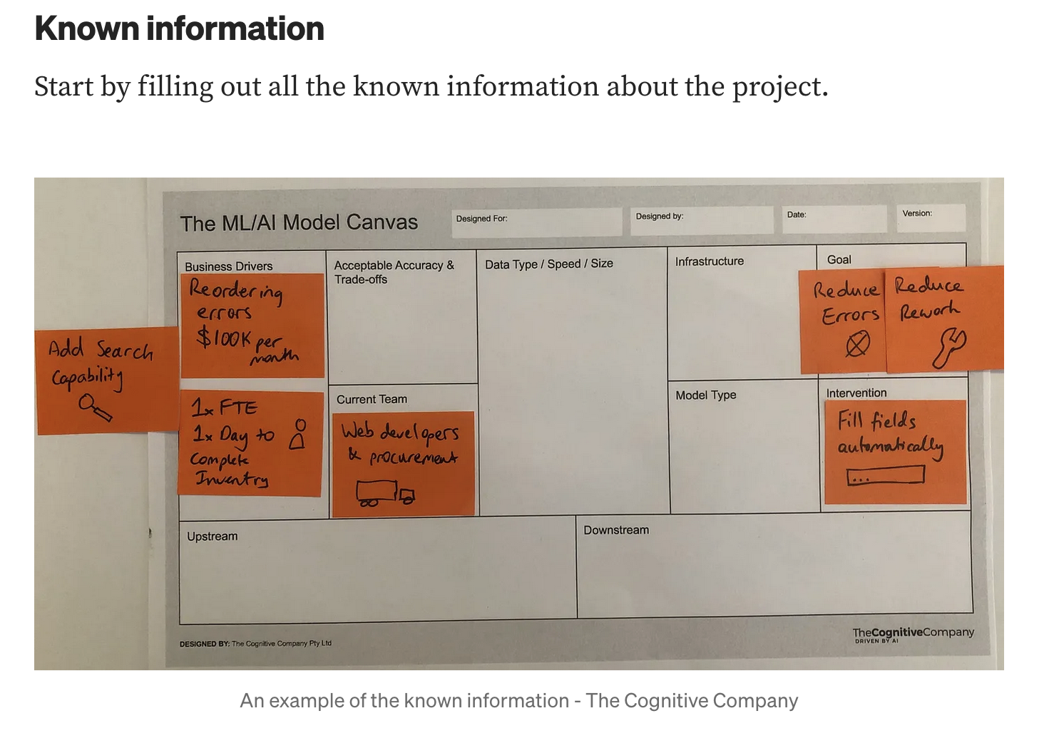

Slide 21
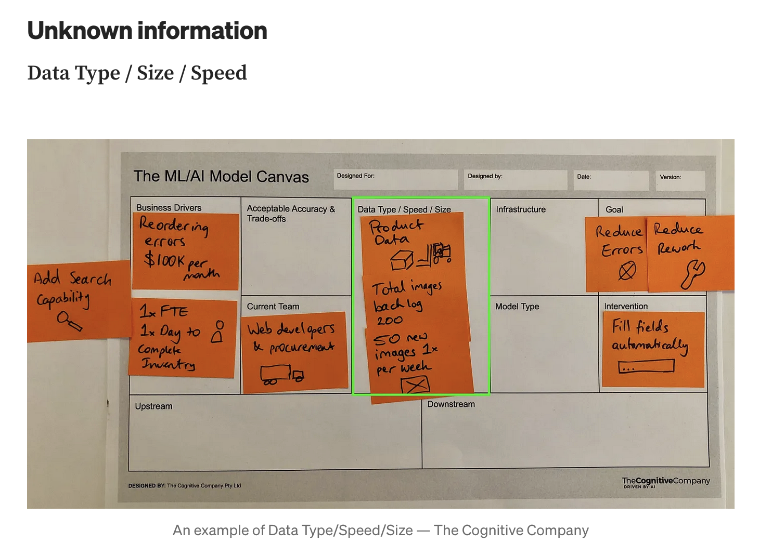

Slide 22
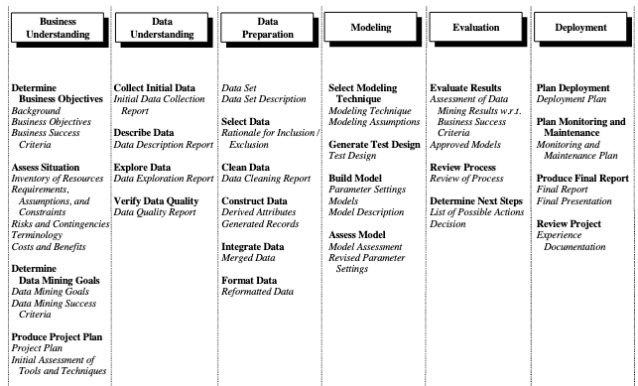

Slide 23
Exercise Corner!
Travel to http://data.europa.eu/ or https://datasetsearch.research.google.com/
Get some data, build your own DM+ML campaign following CRISP-DM
Identify gaps (e.g., things you still don’t know how to fill in CRISP-DM)
You have 1 hr!

Slide 24
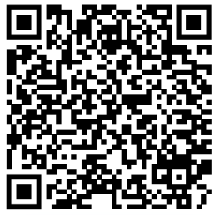
Other sources!*
*courtesy of Jun he

Slide 25
Take the next 45 mins to do it!
The last 15 mins we’ll take a look at 1 instance done by you, and discuss it!

